Slide 1
Counterpoint Generator
By Caleb Nelson and Elliott Claus

Slide 2
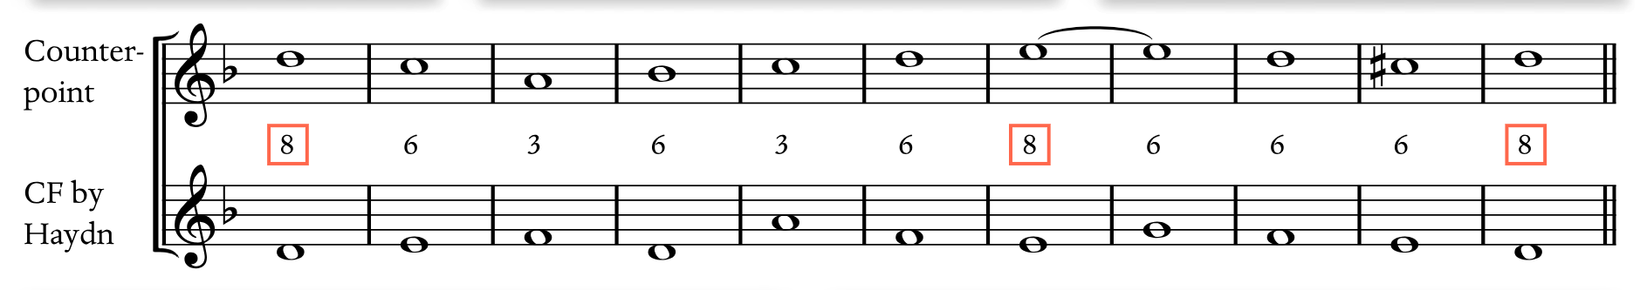
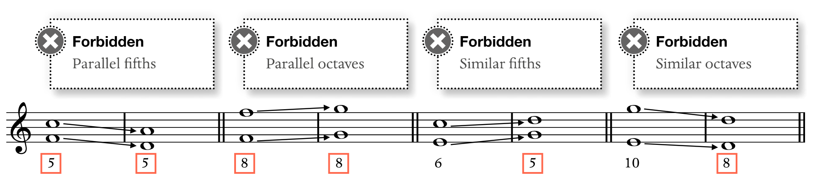
Problem Definition

Slide 3
Requirements and Challenges
Writing music
Saving notes
Using logic to check for errors
Deciding which part of the program does what
Saving music
LilyPond integration
Outputting different lengths
Outputting different keys

Slide 4
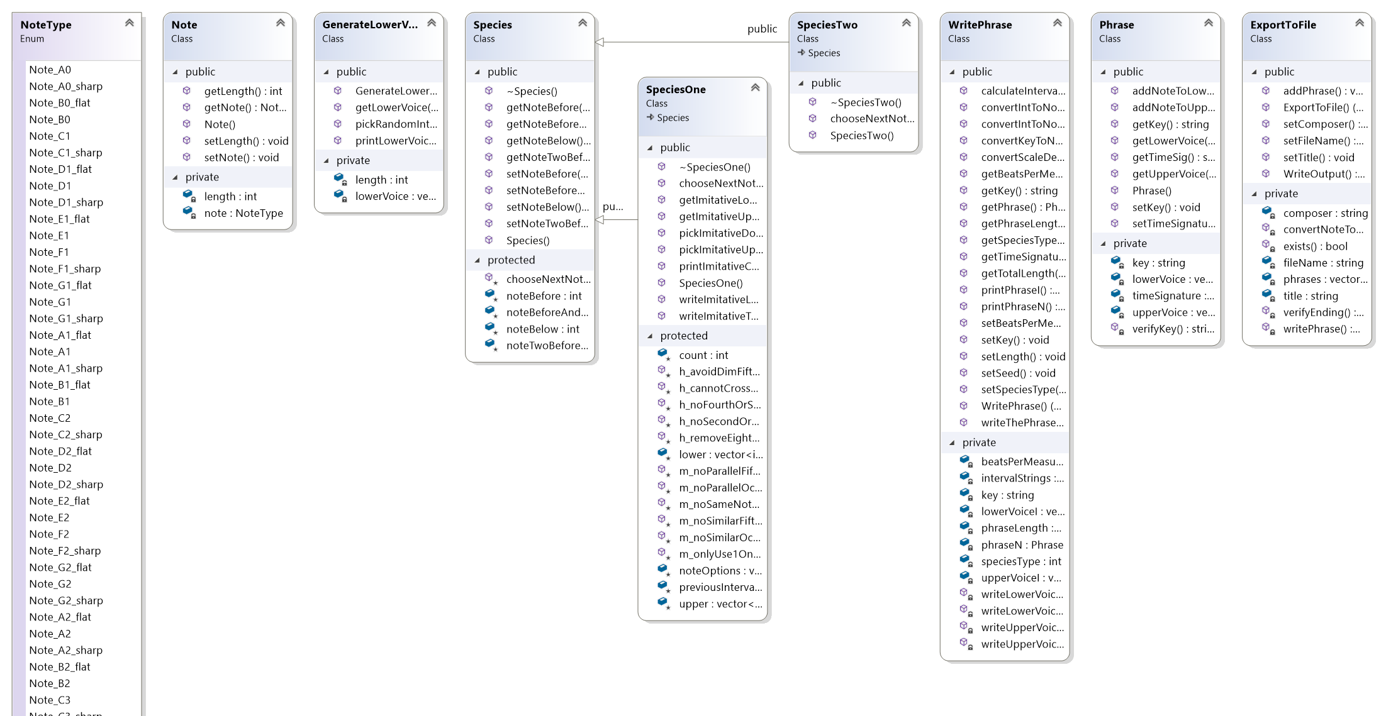
Class Hierarchy Diagram

Slide 5
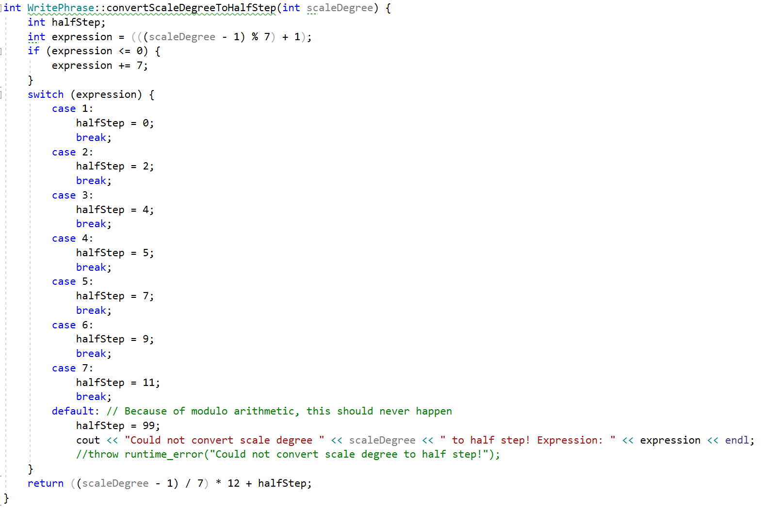
Distinctive Aspects

Slide 6
Distinctive Aspects pt 2

Slide 7
Citations
Burstein, L. Poundie., and Joseph Nathan. Straus. Concise Introduction to Tonal Harmony. W.W. Norton, 2016.

